Slide 1

Capstone Project

Slide 2



Personal BACKGROUND
(Name, Past-Experience, Qualification, Career Summary)
Name : Sruthi R
Past Experience : NA
Qualification : BE – Computer Science And Engineering
Career Summary:
I have begun my career at Ascendion as a Full-Stack Backend Developer. As an aspiring Full-Stack Backend Developer with a solid foundation in software development, I am eager to contribute to innovative projects and excel in my role. I am proficient in Java and possess a strong ability to learn new technologies quickly. I am adept at collaborating effectively within cross-functional teams and am committed to continuous learning and professional development to enhance my technical expertise and contribute to the success of the organization..
www.collaberadigital.com

Slide 3


Key Takeaways/Learnings from the Program (HTD)
Key Learnings
Spring Framework: Gained experience in using Spring Boot for developing microservices and employing Spring Data JPA for effective object-relational mapping (ORM), enhancing the ability to build scalable and modular backend applications.
Core & Advanced Java: Strengthened understanding of Java programming by implementing core functionalities and utilizing advanced features to develop robust and efficient backend systems.
AWS Integration: Learned to deploy services on AWS EC2, utilizing cloud resources for scalable applications, and managed service discovery and load balancing through Eureka.
Feign Client for Inter-Service Communication: Mastered the use of Feign Client to create declarative HTTP clients, streamlining inter-service communication within a microservices architecture.
Testing and Quality Assurance: Developed skills in API testing using Postman, writing unit tests with JUnit, and ensuring code quality through static analysis using Sonar-Lint, contributing to reliable and maintainable codebases.

Slide 4

Problem Statement of the Capstone Project
Overview:
The aviation industry needs a robust system to manage airport operations, aircraft details, and passenger bookings efficiently. Current systems are often disjointed and rely on manual processes, leading to inefficiencies, errors, and security risks. Administrators struggle to keep the system streamlined and responsive to changes, affecting overall performance and customer satisfaction.
Challenges:
Complex Operations: Managing multiple data points for airports, planes, and bookings with high accuracy.
Manual Processes: Dependence on manual handling leads to delays and errors.
Security Risks: Protecting sensitive data and securing administrator access.
Scalability Issues: Need for a system that scales with growing data and user demands.
Integration Difficulties: Challenges in integrating various services for seamless operation.

Slide 5
Problem Statement of the Capstone Project
Objective:
Develop a secure, scalable Air Transport System (ATS) using microservices with Spring Boot and AWS to improve the management of airports, planes, and bookings.
Key Features:
Centralized Platform: Unified management of airports, planes, and bookings.
Automated Processes: Auto-generation of IDs to reduce errors.
Strong Security: Enhanced security measures for data protection.
Scalable Architecture: Microservices with AWS for flexibility and scalability.
User-Friendly Interface: Easy-to-use interface for efficient management.
Outcome:
The ATS will streamline operations, reduce errors, enhance security, and improve efficiency, leading to better service quality and customer satisfaction.

Slide 6
Table of Contents
1. System Architecture
Microservices Overview
Database Overview
2. Microservices Details
Login and Authentication Microservice
Airport Management Microservice
Plane Management Microservice
Booking Management Microservice
3. Database Design
ER Diagram
4. Requirements
US01: Administrator & Login
US02: View Airports
US03: Manage Airports
US04: View Planes
US05: Manage Planes
US06: View Bookings
US07: Manage Bookings

Slide 7
Table of Contents
5. Functional Requirements
ORM with Spring Data JPA
MySQL Database
Code Quality
Naming Conventions
Exception Handling
Modular Design
6. Testing
Junit
Sonarlint
Postman
7.Deployment
Service Registry with Eureka
Service Registry with Feign Client
8.Conclusion

Slide 8
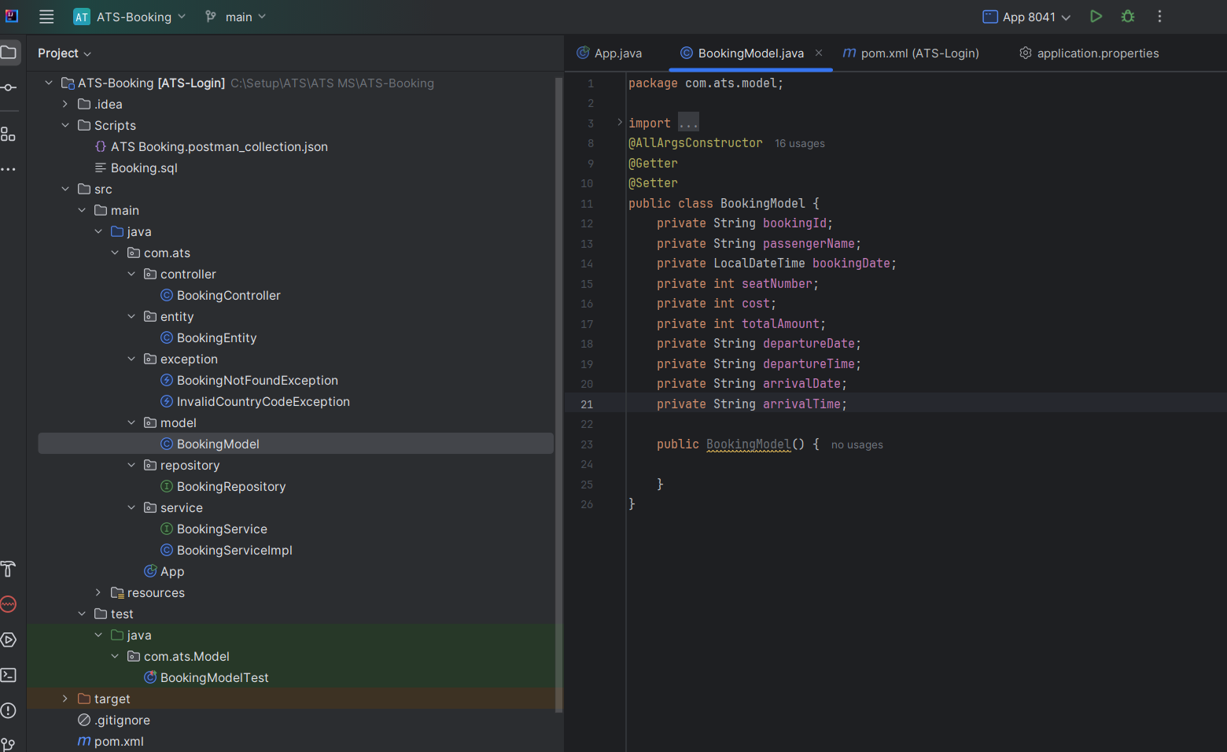
Screenshot of Booking Micro-Service

Slide 9
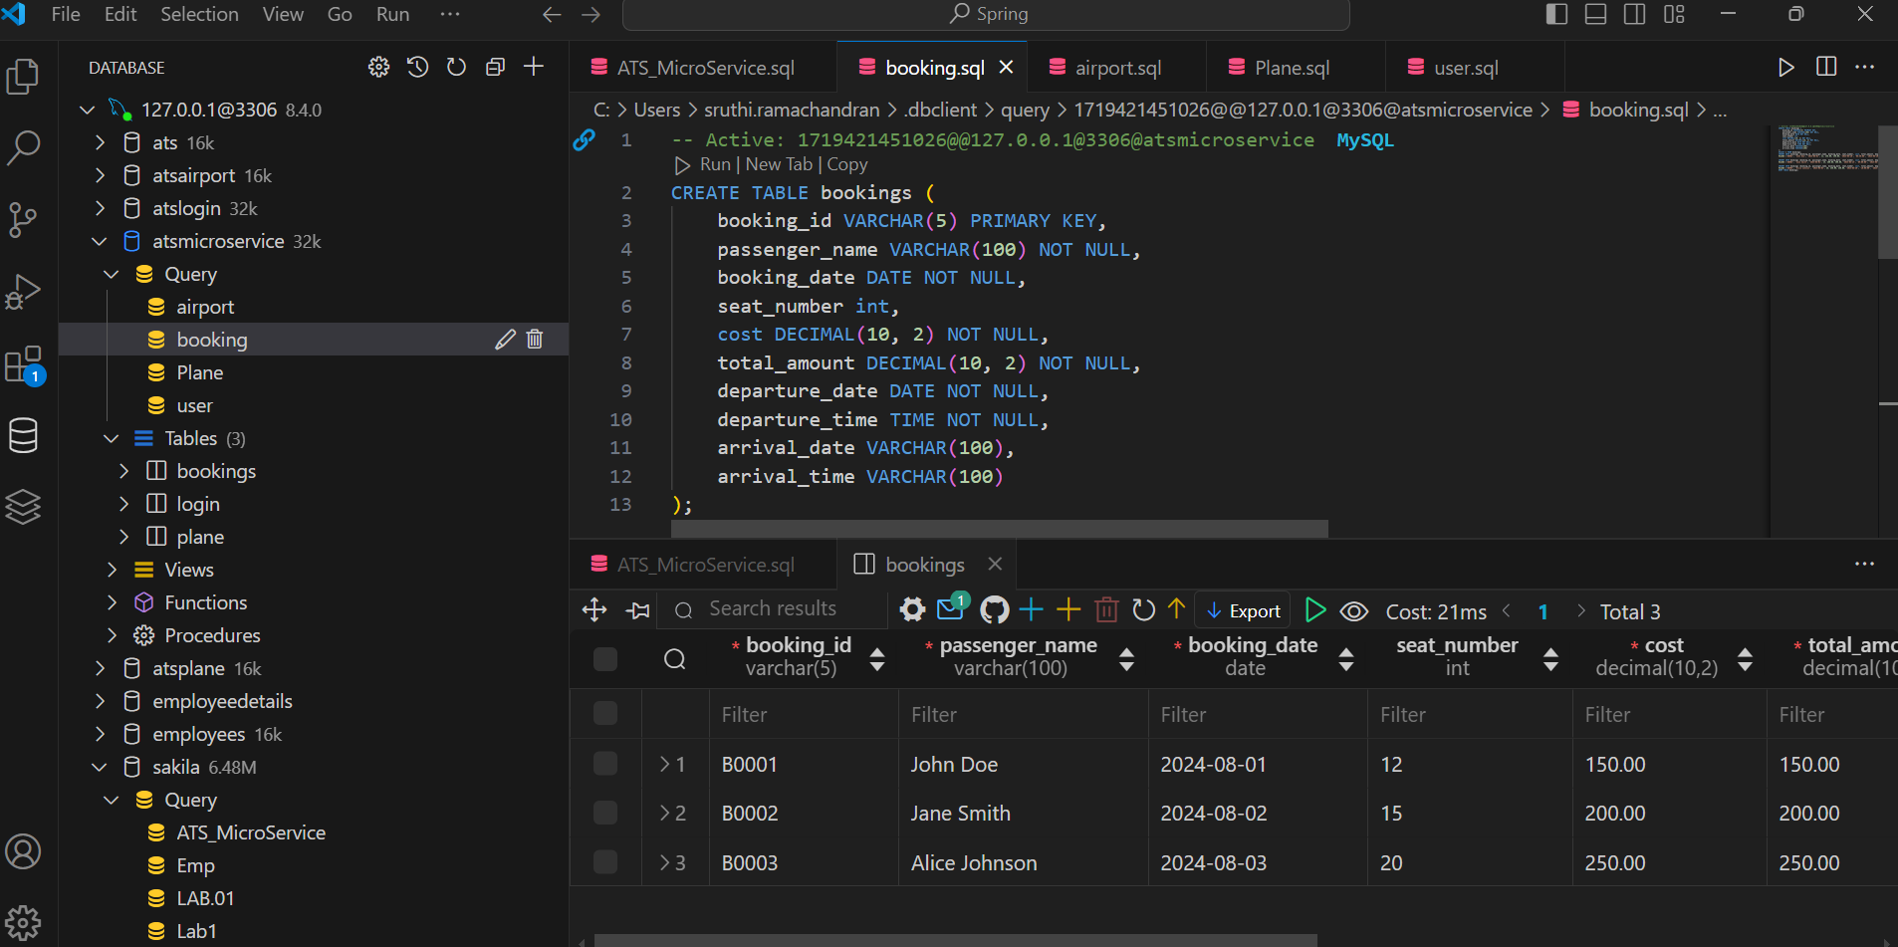
Screenshot of Database

Slide 10

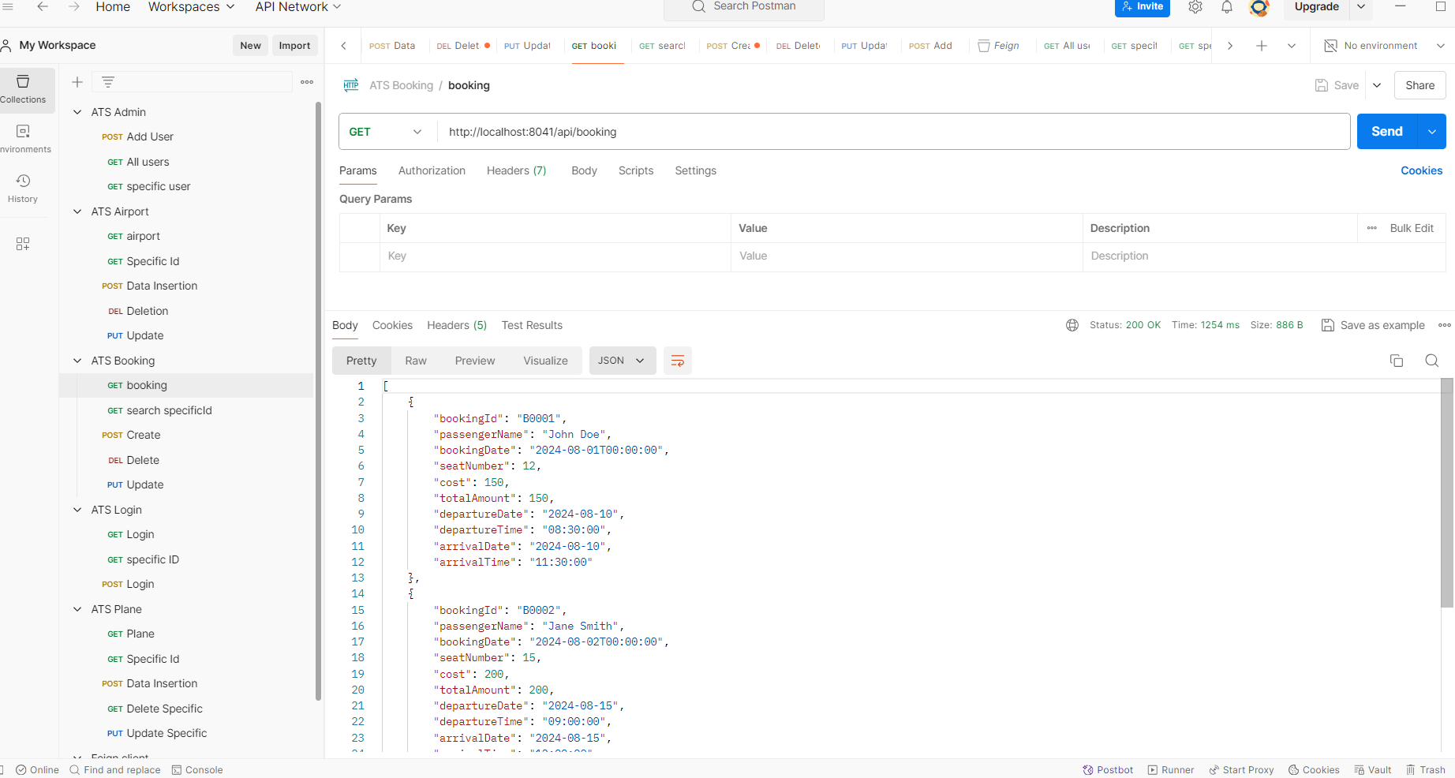
Screenshot of Postman

Slide 11

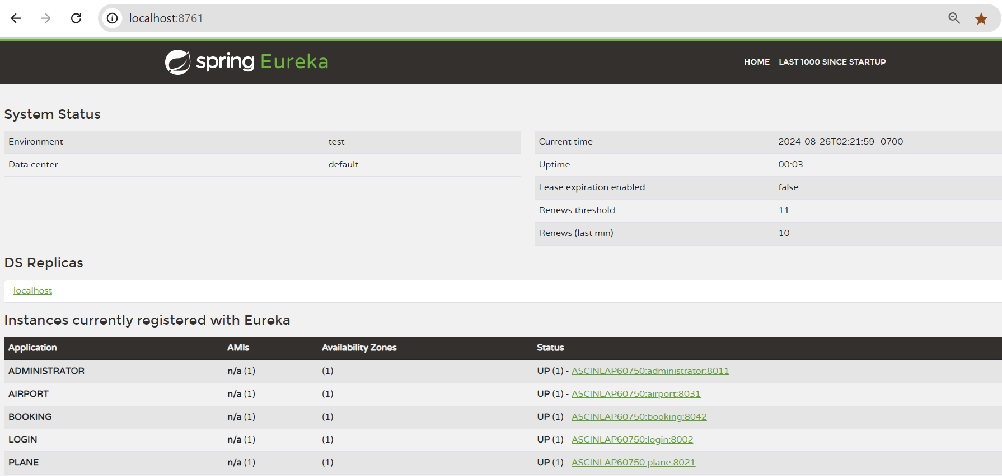
Screenshot of spring Eureka

Slide 12
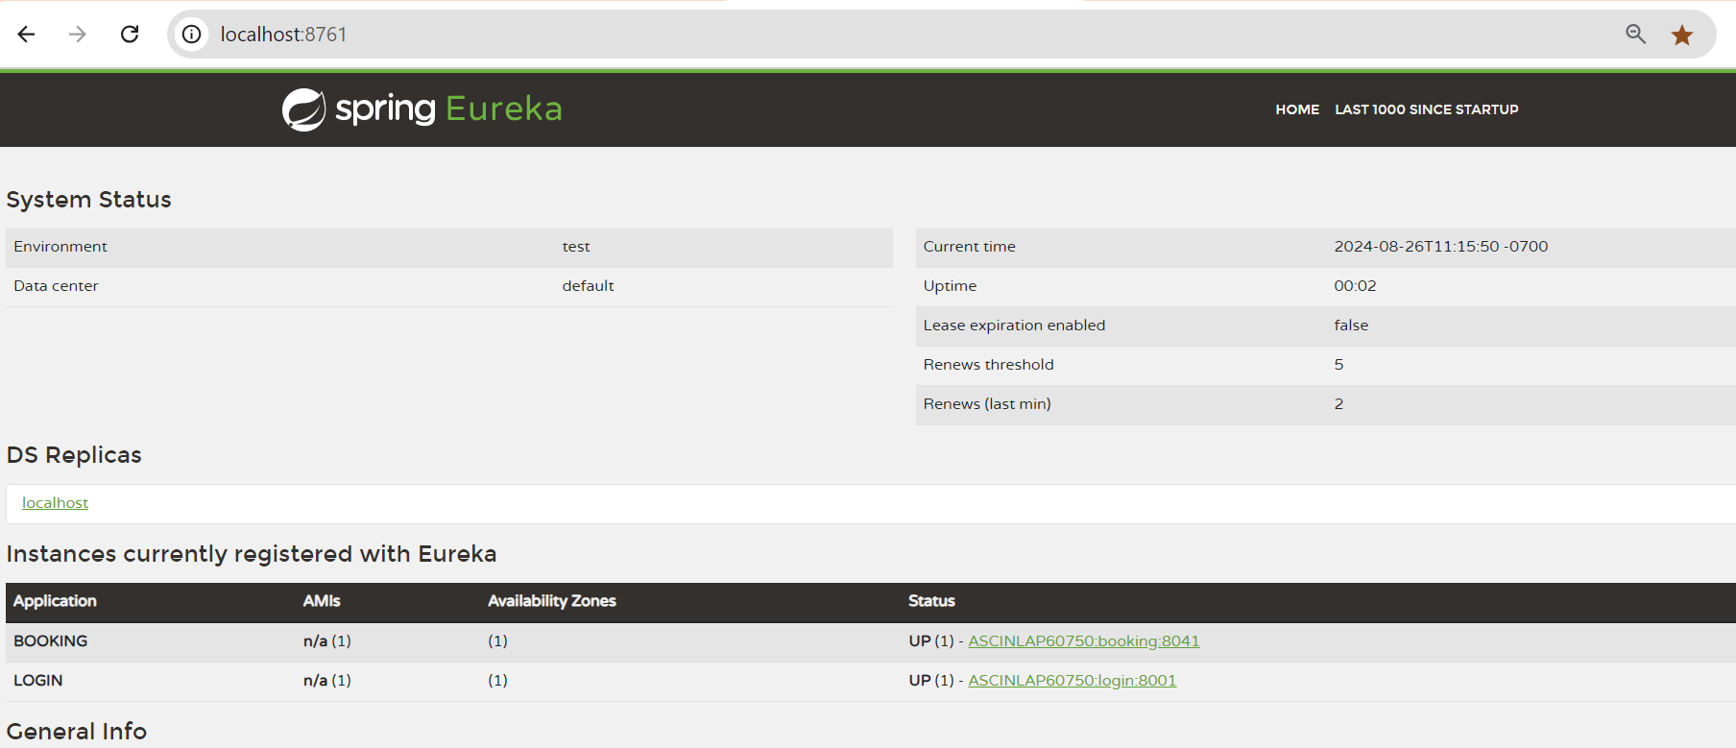
Screenshots of Feign-Client (Eureka)

Slide 13
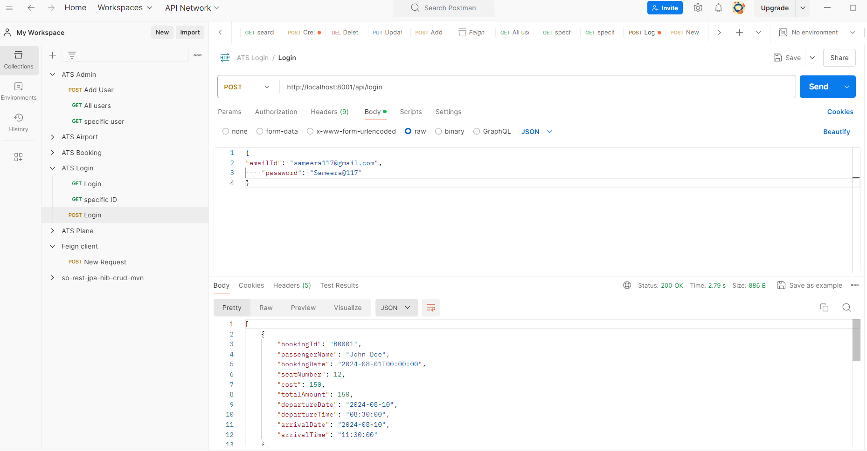
Screenshot of Feign-Client(Postman)

Slide 14
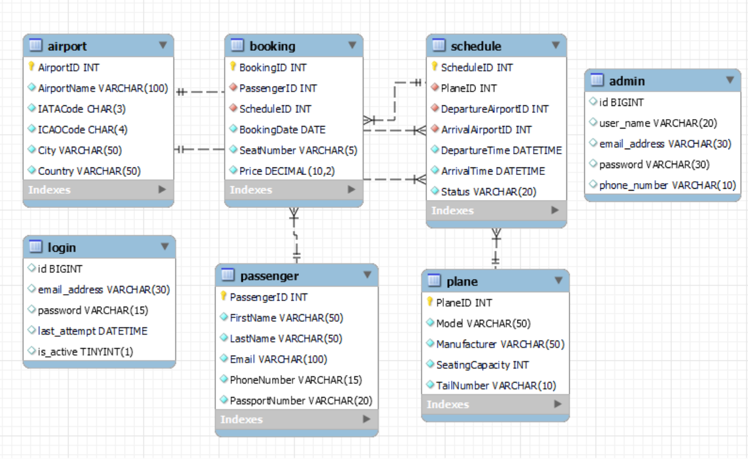
Entity-Relationship Diagram

Slide 15
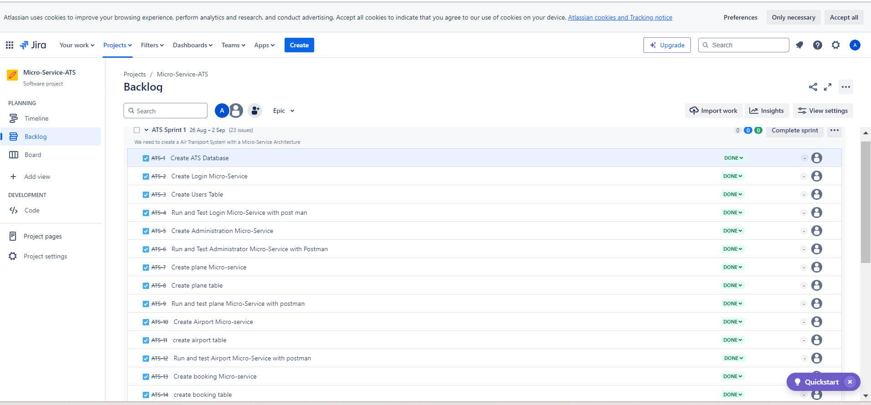
Screenshot of JIRA

Slide 16
Conclusion
The Air Transport System (ATS) project aims to address the key challenges faced by the aviation industry by providing a comprehensive, scalable, and secure platform for managing airport operations, aircraft details, and passenger bookings. By leveraging a microservices architecture with Spring Boot and AWS, ATS ensures efficient data management, robust security, seamless integration, and enhanced scalability. This solution not only streamlines administrative processes but also minimizes errors and enhances the overall user experience. Implementing ATS will lead to improved operational efficiency, increased security, and higher customer satisfaction, positioning the system as a vital tool for modernizing air transport management.
This project demonstrates the importance of integrating advanced technology with best practices in software design to solve real-world problems, paving the way for future innovations in the aviation sector.

Slide 17
Thank You

